Slide 1
Development of CAM systems for the Incremental Forming of CFRTP from 3D CAD data
Sophia University, Faculty of Science and Technology, Green Engineering Program
Precision Engineering Laboratory
A2177802 Karter Wong
Notes:
Hello. My name is Karter Wong, and I will be presenting my research topic: the Development of CAM systems for the Incremental Forming of CFRTP from 3D CAD data.

Slide 2
Presentation content
Background Information
Previous Research
Research Goals
Experiment Overview
Conclusion
Future Work
Notes:
Today, I will briefly review some background information, the previous research on the topic, the progress that I have made during this past year, a brief overview of the Experiment, the result, and finally summarize the findings and improvements that can be made for this research topic.

Slide 3
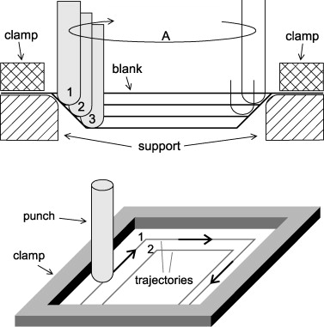
Background Information Incremental Forming
Incremental forming: A flexible forming process that can shape sheets of various materials using plastic deformation of the sheet with a tool into the desired shape.
Characteristics: High design flexibility, No need for molds, Specialized for thin shell shapes, Suitable for small-volume, diversified production
Principle of Single Point Incremental forming [Iseki et al., 1989].
Notes:
So, what is Incremental forming?
Incremental forming is a flexible forming process that can shape sheets of various materials using plastic deformation of the sheet with a tool into the desired shape.
Unlike traditional manufacturing processes, it does not require dies or molds, making it ideal for low-volume production, prototyping, or custom parts. The tool follows a programmed path to manufacture shell shapes, offering reduced setup and production costs.
It also allows the production of various products in small quantities, where mold creation would be too expensive.

Slide 4

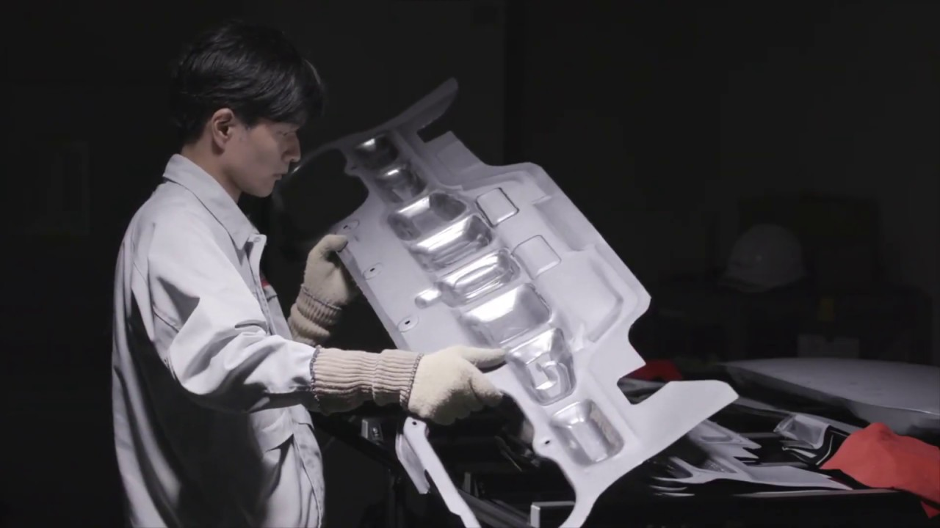
Background Information Incremental Forming
Nissan’s Incremental
Forming Showcase
Lexus LC Edge
Notes:
An example of Incremental forming in use today is by car manufacturers like Ford, Nissan, and Lexus. These manufacturers use incremental forming to prototype new vehicle designs and add minor customizations to vehicles, as seen on the Lexus LC edge, as shown here.

Slide 5

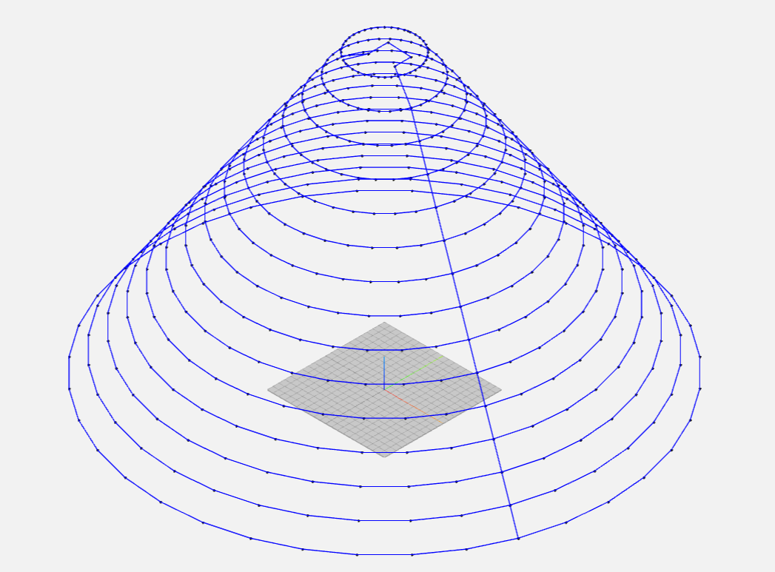
Previous Research
Point Cloud Formation
Toolpath Generation
G-Code
STL Data
Notes:
My research is based on a previous research project that developed a simple Python-based CAM system that could generate a tool path and conducted experiments to test the tool path.
The CAM system developed during the previous research can be described in four steps:
First, STL data from the 3D CAD data is converted into a point cloud, a collection of points from the triangles given by the STL file.
Next, the point cloud's points are grouped into layers defined by the Z coordinate. During this process, the program looks for the points on the outermost part of the figure so that the toolpath is not generated with unnecessary movements.
Third, the toolpath is calculated by calculating the distances from the tool's current position to the other points on the layer and moving to the point with the shortest distance. This process is repeated for each layer of the shape.
The final step is to convert the X, Y, and Z coordinates into G-code so that a CNC machine can read the generated tool path and manufacture a product.

Slide 6
Research Goals
Research Goals:
Error-free toolpaths for complex geometries
Reducing generation time for complex geometries
Streamlining the design-to-manufacturing process
Notes:
The CAM system, while effective for simple shapes, had limitations when applied to more complex shapes. These included generating inefficient toolpaths with unnecessary tool movements, long toolpath generation times, and an overall inefficient workflow to go from design to manufacturing. The changes made to the CAM system in this research study address these issues.

Slide 7
CAM System Changes CAM System Overview
STL Loading Method
Point Processing and Filtering
Layer Identification
Per-Layer Path Generation
Path Ordering and Connection
G-Code Generation
Configurability
Output Precision and Rounding
Offsets and Adjustments
Notes:
The enhancements to the CAM system can be categorized into nine key areas, visualized in these boxes, which address the issues previously mentioned.
The top six boxes, focus on point management. They filter and remove duplicate or invalid points that could skew the path; sort points more efficiently by the Z coordinate; introduced rounding mechanisms to enhance toolpath accuracy; removing layers with fewer than five points; and optimized the toolpath generation to minimize unnecessary loops or jumps.
The bottom-left box handles CNC-specific criteria such as a tool's diameter, compensates for material springback, and considers the physical limits of the machining center, such as travel ranges and safety boundaries.
Finally, the last two boxes enhance usability, and users can now customize the G-code output based on specific equipment or experimental conditions, and the system automatically adds the initial setup commands and termination sequences, speeding up the experimental process.

Slide 8
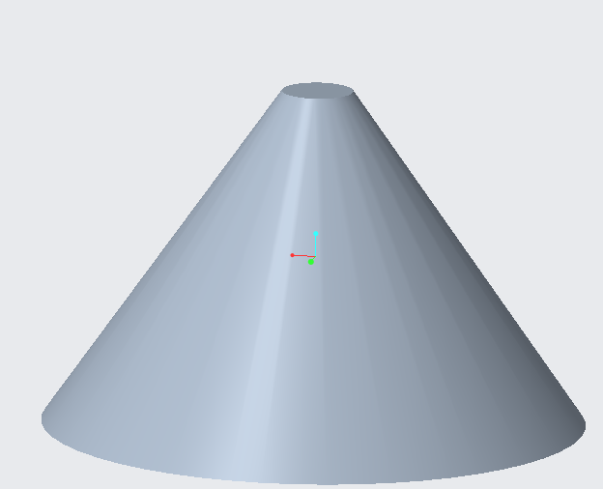
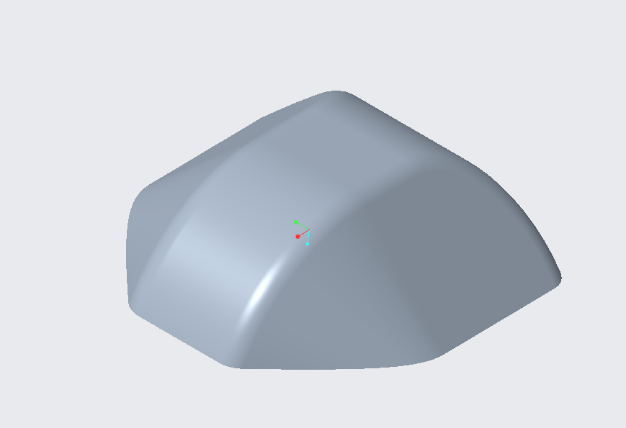
Test Shape Change
2 mm
9.9 mm
15 mm
30 mm
30 mm
20 mm
Previous Research’s
Test Shape
Current Test Shape
Notes:
To evaluate these changes to the CAM system, a more challenging test shape was used instead of the truncated cone used in the prior research.
The new shape is a rectangular prism with chamfered and rounded edges, measuring 30 mm by 30 mm by 9.9 mm thick.
These dimensions were chosen to fit within the CNC machine, ensure no sharp 90-degree angles, introduce sufficient complexity to stress-test the path generation, and mimic real-world parts.

Slide 9
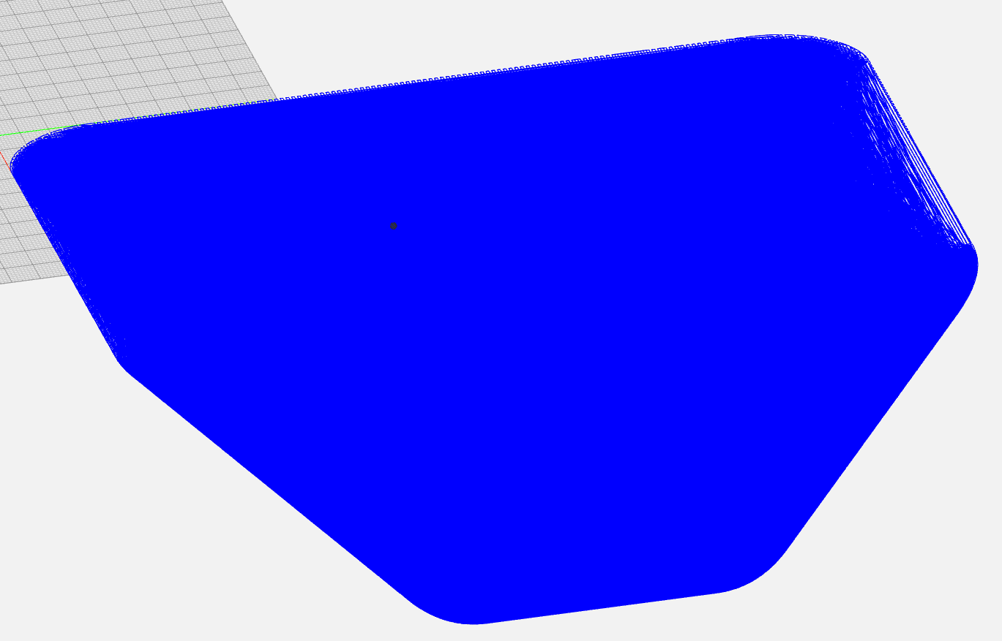
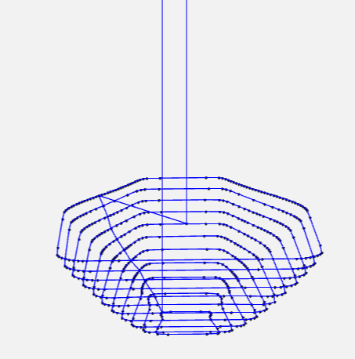
Experimental Results CAM System Tests
Previous Research
CAM System
Updated CAM System
Generation Time: 2 seconds
Generation Time: 2.5 hours
Notes:
When generating the toolpath for this test shape, the updated CAM system significantly reduced toolpath generation time from the previous research's 2.5 hours to 2 seconds. The toolpaths of both CAM systems were simulated using NCviewer to check for any toolpath errors.
As you can see from the figures, the previous CAM system adds a lot of unnecessary points to the toolpath, causing an increased generation time.

Slide 10
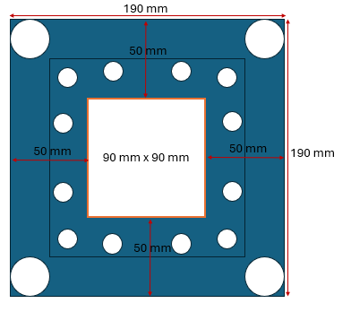
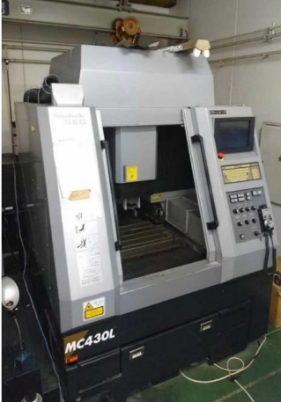
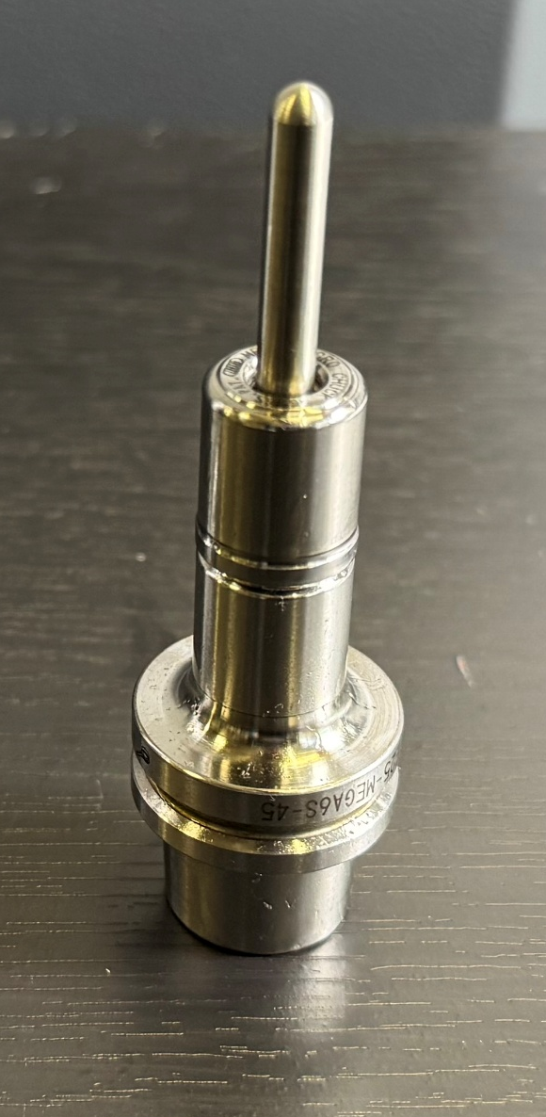
Experimental Equipment
Machining Tool
Jig Dimensions
MC430L
Machining center
Notes:
With the tool path verified, the incremental forming trials using an MC430L machining center could begin. The workpiece was a 110 mm by 110 mm by 1 mm sheet of CFRTP, secured over a custom mold measuring 89.92 mm by 89.92 mm by 20 mm. The forming tool used was a 5 mm diameter rod, as shown here.

Slide 11
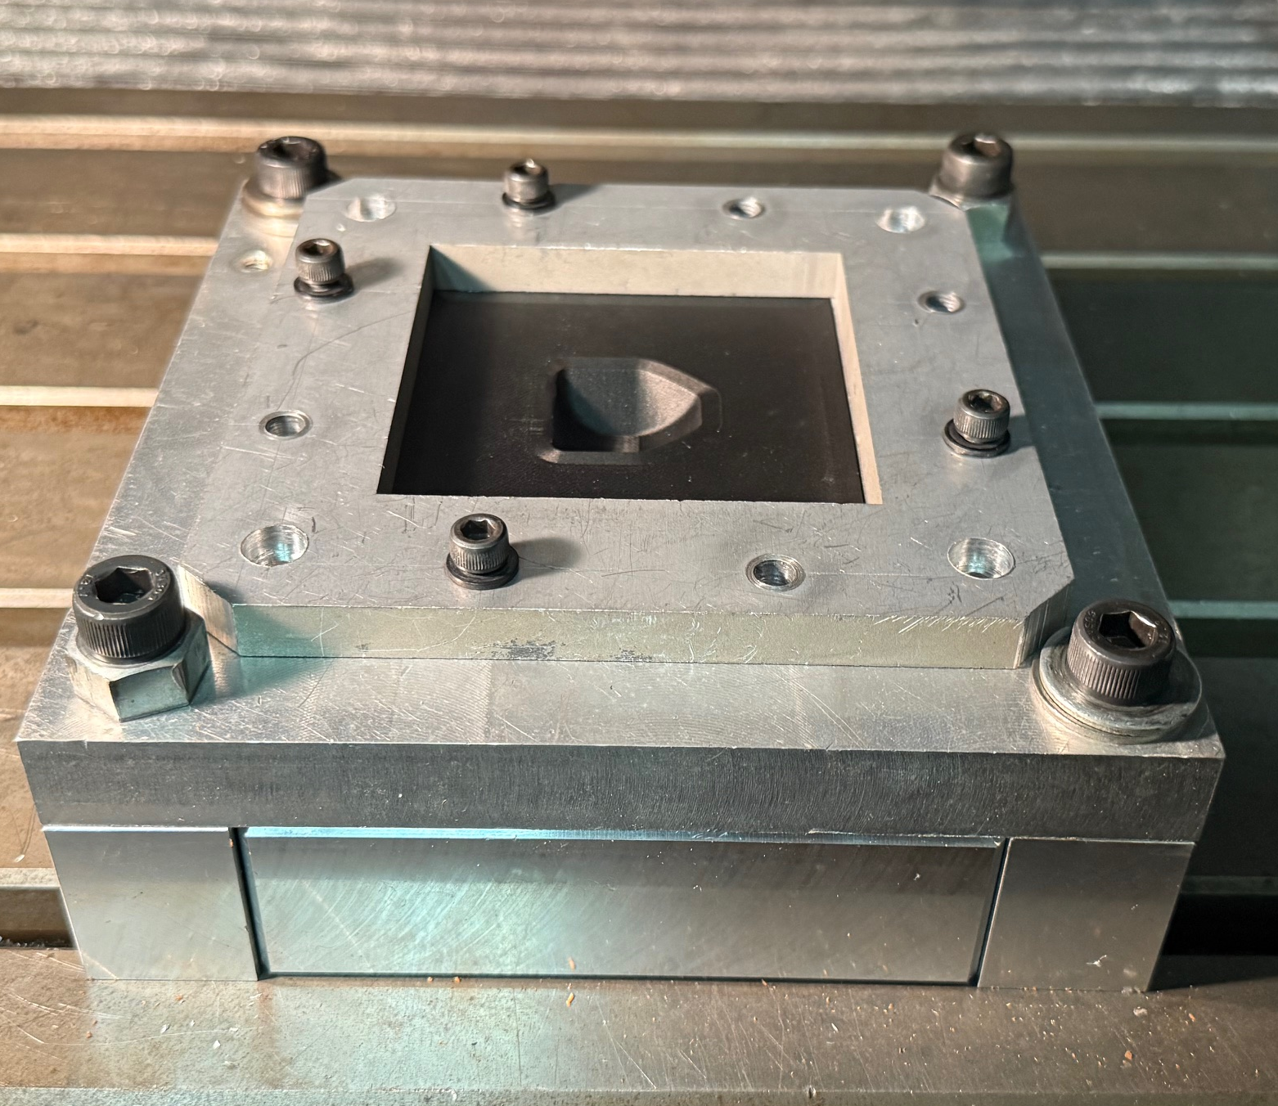
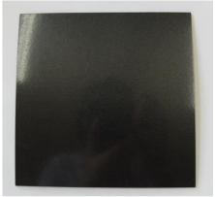
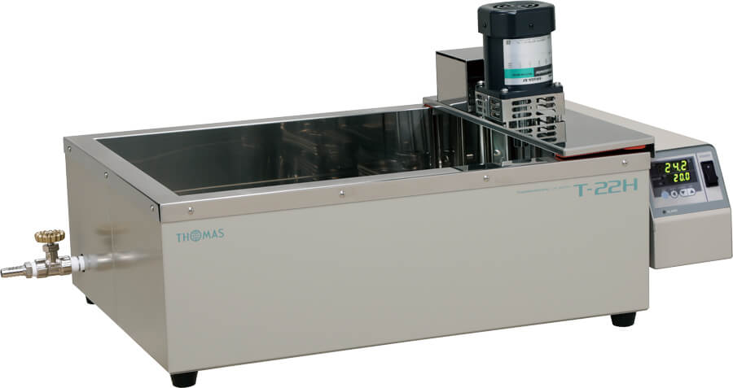
Experimental Setup
Jig with Mold
CFRTP Test Piece
T-22H Oil Bath
Notes:
For the CFRTP experiments, a T-22 H oil bath system was used to uniformly and precisely heat the silicon oil and CFRTP to the required temperature. The jig, holding the mold, is mounted at the bath's base, with the CFRTP sheet secured to the jig.
This controlled heating is needed for the incremental forming of CFRTP, as its formability is better when heated, allowing for deeper forming depths and better shape retention compared to room-temperature processing.

Slide 12
Experimental Results CFRTP Tests
Tests Without a Mold With CFRTP
Test Number | Feed Rate (mm/min) | Spindle Speed (RPM) | Temperature (Degrees C) | Forming depth (mm)
1 | 1000 | 500 | 150 | 9.85
Tests With a Mold with CFRTP
Test Number | Feed Rate (mm/min) | Spindle Speed (RPM) | Temperature (Degrees C) | Forming depth (mm)
1 | 400 | 400 | 120 | 9.96
2 | 1000 | 500 | 120 | 8.75
3 | 1000 | 500 | 150 | 10.80
Notes:
In this study, four types of incremental forming tests were done—tests using nylon sheets and discontinuous CFRTP as materials, and both with and without the mold. The nylon trials were used to prove toolpath feasibility and won't be explained, as the focus is on CFRTP performance.
The feed rate and spindle speed are based on the previous research's experimental conditions. The first test here has a slower speed as a safety measure, as it was the first test that was done with the heated oil bath.
For CFRTP, four tests were performed under varying conditions, as shown on the slide. The two at 120 degrees Celsius had rough surfaces and fracturing because the sheets were removed from the oil bath too early, causing uneven cooling. The 150-degree tests succeeded in forming the test shape with no fracturing and relatively smoother surfaces.
Due to technical issues with our 3D scanner, a detailed analysis was limited, so the only measurement taken was the forming depth, as it was the only one that could be taken accurately.

Slide 13
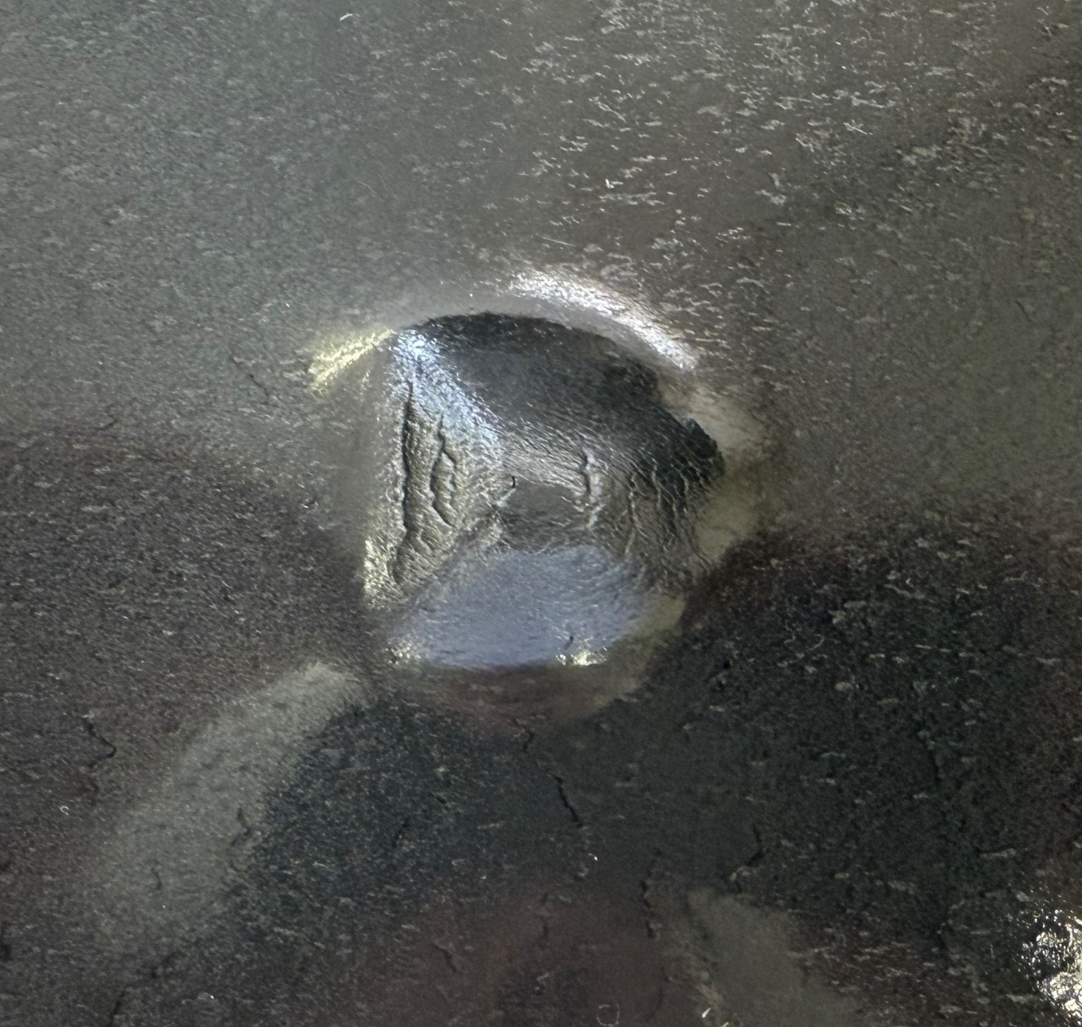
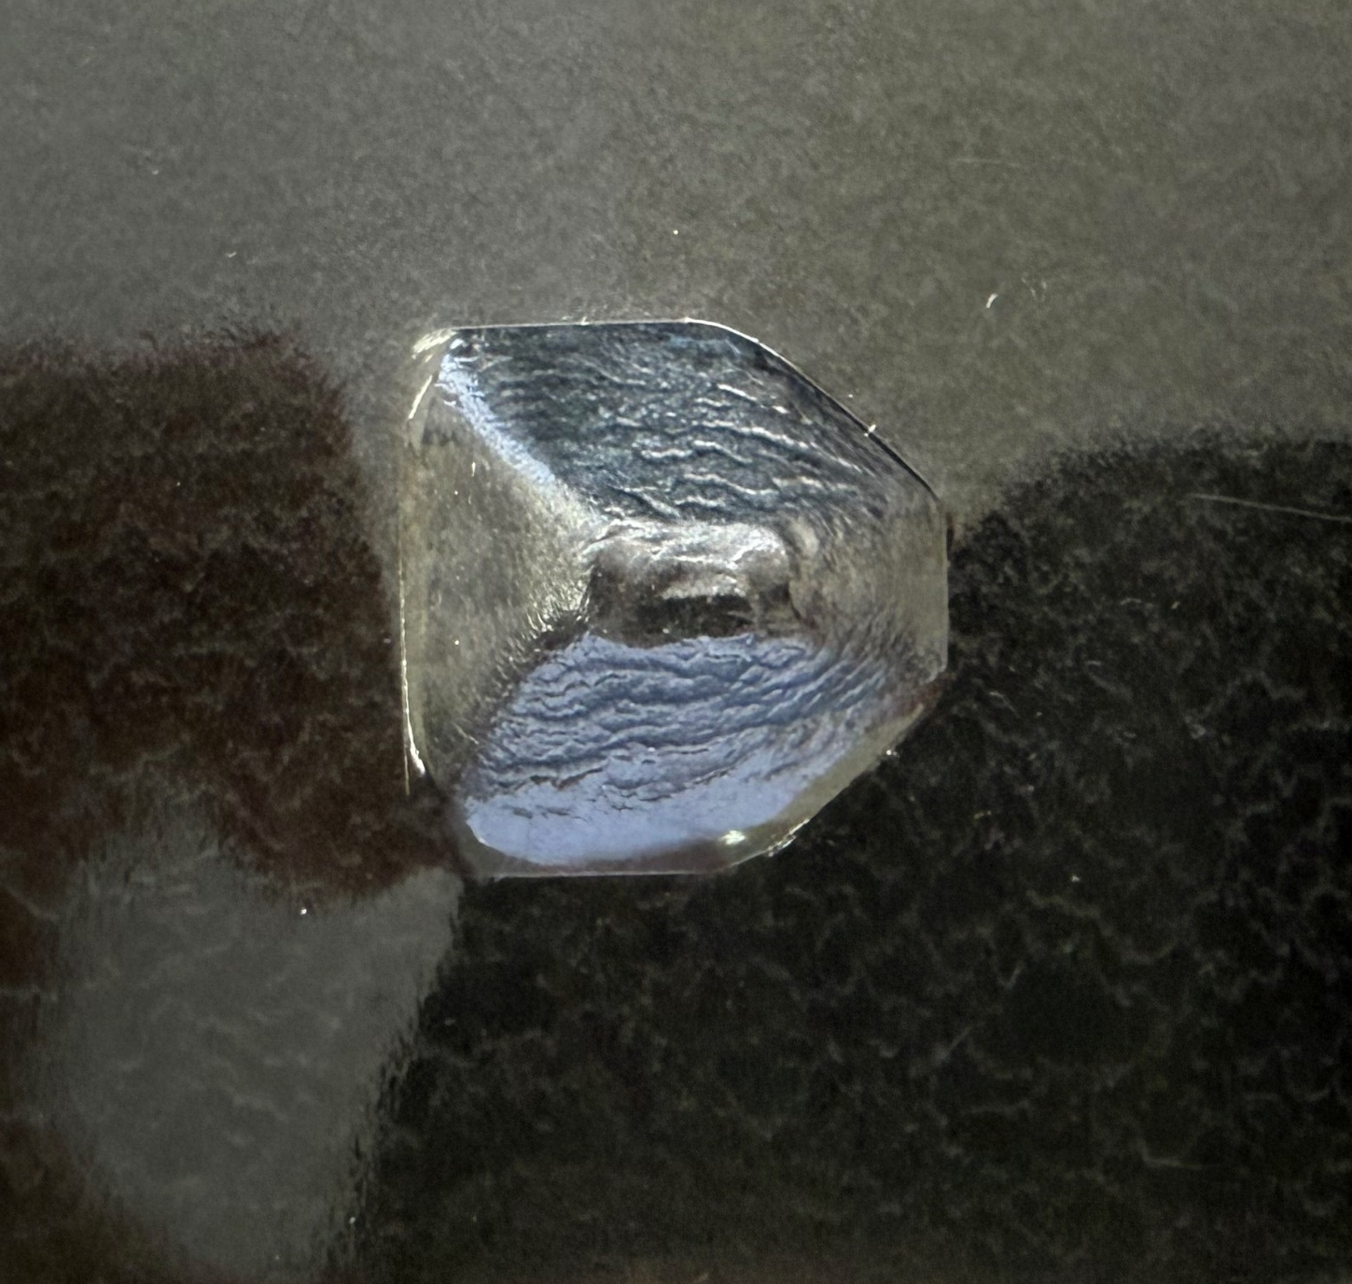
Discussion
Tests Without a Mold With CFRTP
Test Number | 1
Feed Rate (mm/min) | 1000
Spindle Speed (RPM) | 500
Temperature (Degrees C) | 150
Forming depth (mm) | 9.85
Test 1
Tests With a Mold with CFRTP
Test Number | 3
Feed Rate (mm/min) | 1000
Spindle Speed (RPM) | 500
Temperature (Degrees C) | 150
Forming depth (mm) | 10.80
Test 3
Notes:
A visual side-by-side comparison of the CFRTP results with and without the mold shows advantages to using a mold: The max depth of a test with a mold was 10.8 mm, exceeding the 9.9 mm target depth, and preserved the geometry with higher fidelity whereas the test without the mold did not.
These results confirm that the upgraded CAM system can generate reliable tool paths for complex shapes incremental forming of CFRTP.

Slide 14
Conclusion
Concluding remarks:
99% reduction in generation time
5% margin of error
Forming conditions were consistent with the previous research
Notes:
In summary, the changes made to the previous CAM system solved several issues, such as generating precise tool paths for intricate shapes, reducing generation times to near-instantaneous levels, and simplifying the workflow for faster prototyping.
The forming depths averaged within a 5% margin of error, with the molds having less error. The 150°C temperature proved optimal, consistent with earlier findings. However, this data set is small, so the data may not be accurate.

Slide 15
Future Work
Future Work:
CAM System Optimization
  Automatic Origin Detection
Setup Improvements
  Cooling Methods for the Oil Bath
Analysis Enhancements
  Acquiring a Better 3D Scanner
Notes:
That said, there are further improvements to be made. On the CAM side, additional optimizations could include automated origin detection for the workpiece and jig, accelerating setup times by eliminating manual alignment, which currently slows down experiments.
Experimentally, developing a way to cool the oil bath would enable multiple tests per day, as the current cooldown period restricts experiments to one a day.
Lastly, getting a 3D scanner would allow comprehensive post-forming analysis, including thickness uniformity and geometric deviation metrics, for deeper insights.

Slide 16
Citations
【1】 Bagherifard, S., Ghelichi, R., & Guagliano, M., "Shot peening: A review of the process and its applications," Journal of Materials Processing Technology, vol. 258, pp. 188–202, 2018.
【2】 Duflou, J. R., Habraken, A. M., Cao, J., Malhotra, R., Bambach, M., Adams, D., ... & Merklein, M., "Single point incremental forming: An assessment of the progress and technology trends from 2005 to 2015," Journal of Manufacturing Processes, vol. 28, no. 3, pp. 373–391, 2018.
【3】 Guttag, J. V., Introduction to computation and programming using Python, 3rd ed., The MIT Press, 2021.
[4] Tatsuki Ikari, Hidetake Tanaka, Feasibility Study of Single-Point Incremental Forming for DiscontinuousFiber CFRP using oil bath heating International Journal of Automation Technology, Vol. 18, No. 3, 433-443, 2024
[5] Hidetake Tanaka, Kippei Yamada and Tatsuki Ikari, Feasibility Study of Laser-assisted Incremental Forming for CFRTP based on 3D-CAD data, International Journal of Automation Technology, Vol. 17, No. 2, 144-155,2023
【6】 Mitsumori, T., "Development of incremental forming techniques for automotive CFRP components," Sophia University Technical Report, 2023.
Notes:
Here are my citations. Thank you for your attention

Slide 17
Citations
【7】 Sharma, V., Sharma, V., & Shukla, O. J., Principles and practices of CAD/CAM, Katson Books, 2014.
【8】 Shovic, J. C., & Simpson, A., Python all-in-one for dummies, Wiley, 2021.
【9】 Smid, P., CNC programming techniques, Industrial Press, 2006.
【10】 Tanata, H., "Carbon-fiber-reinforced-polymer manufacturing techniques," Sophia University Technical Report, 2023.
【11】 "Radiolucent Carbon Fiber–Reinforced Pedicle Screws for Treatment of Spinal Tumors: Advantages for Radiation Planning and Follow-Up Imaging," ScienceDirect. [オンライン]. Available: https://www.sciencedirect.com/science/article/abs/pii/S1878875017305971(Last accessed on 2024/07/07)
【12】 "State of the Art in Incremental Forming," PMC. [オンライン]. Available: https://pmc.ncbi.nlm.nih.gov/articles/PMC11642863/ (Last accessed on 2024/07/07)
【13】 "Incremental Forming," ScienceDirect. [オンライン]. Available: https://www.sciencedirect.com/topics/engineering/incremental-forming (Last accessed on 2024/07/07)

Slide 18
Citations
【14】 "The technology of Incremental Sheet Forming—A brief review of the history," ScienceDirect. [オンライン]. Available: https://www.sciencedirect.com/science/article/abs/pii/S0924013610000555 (Last accessed on 2024/07/07)
【15】 Bachmann, J., Hidalgo, C., & Bricout, S., "Environmental analysis of innovative sustainable composites with potential use in aviation sector—A life cycle assessment review," Science China Technological Sciences, vol. 60, pp. 1301–1317, 2017.
【16】 "Product Page for 61-3235-86," Axel Global. [オンライン]. Available: https://www.axel-gl.com/en/asone/d/61-3235-86/ (Last accessed on 2024/07/07)

Slide 20
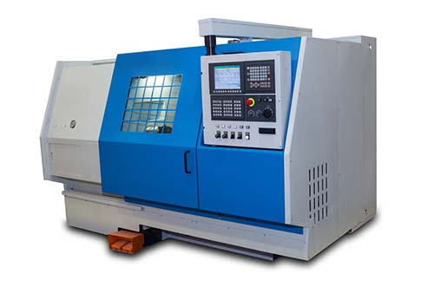

Background Information
What is CAD and CAM
CAD (Computer Aided Design)
CAM (Computer Aided Machining)
CAD
CAM
Notes:
What are CAD and CAM systems?
CAD and CAM systems are different technologies used for product design and manufacturing.
CAD software creates, modifies, analyzes, and optimizes 2D or 3D digital models of physical objects. Engineers and designers can visualize designs, perform simulations, and generate precise technical drawings. Some examples of CAD software are Creo and Fusion 360.
CAM systems are software that uses CAD models to control and automate manufacturing processes, such as CNC machining, and 3D printing. The software generates tool paths and instructions for machines to produce parts efficiently and precisely.
(Computer Numerical Control)

Slide 21
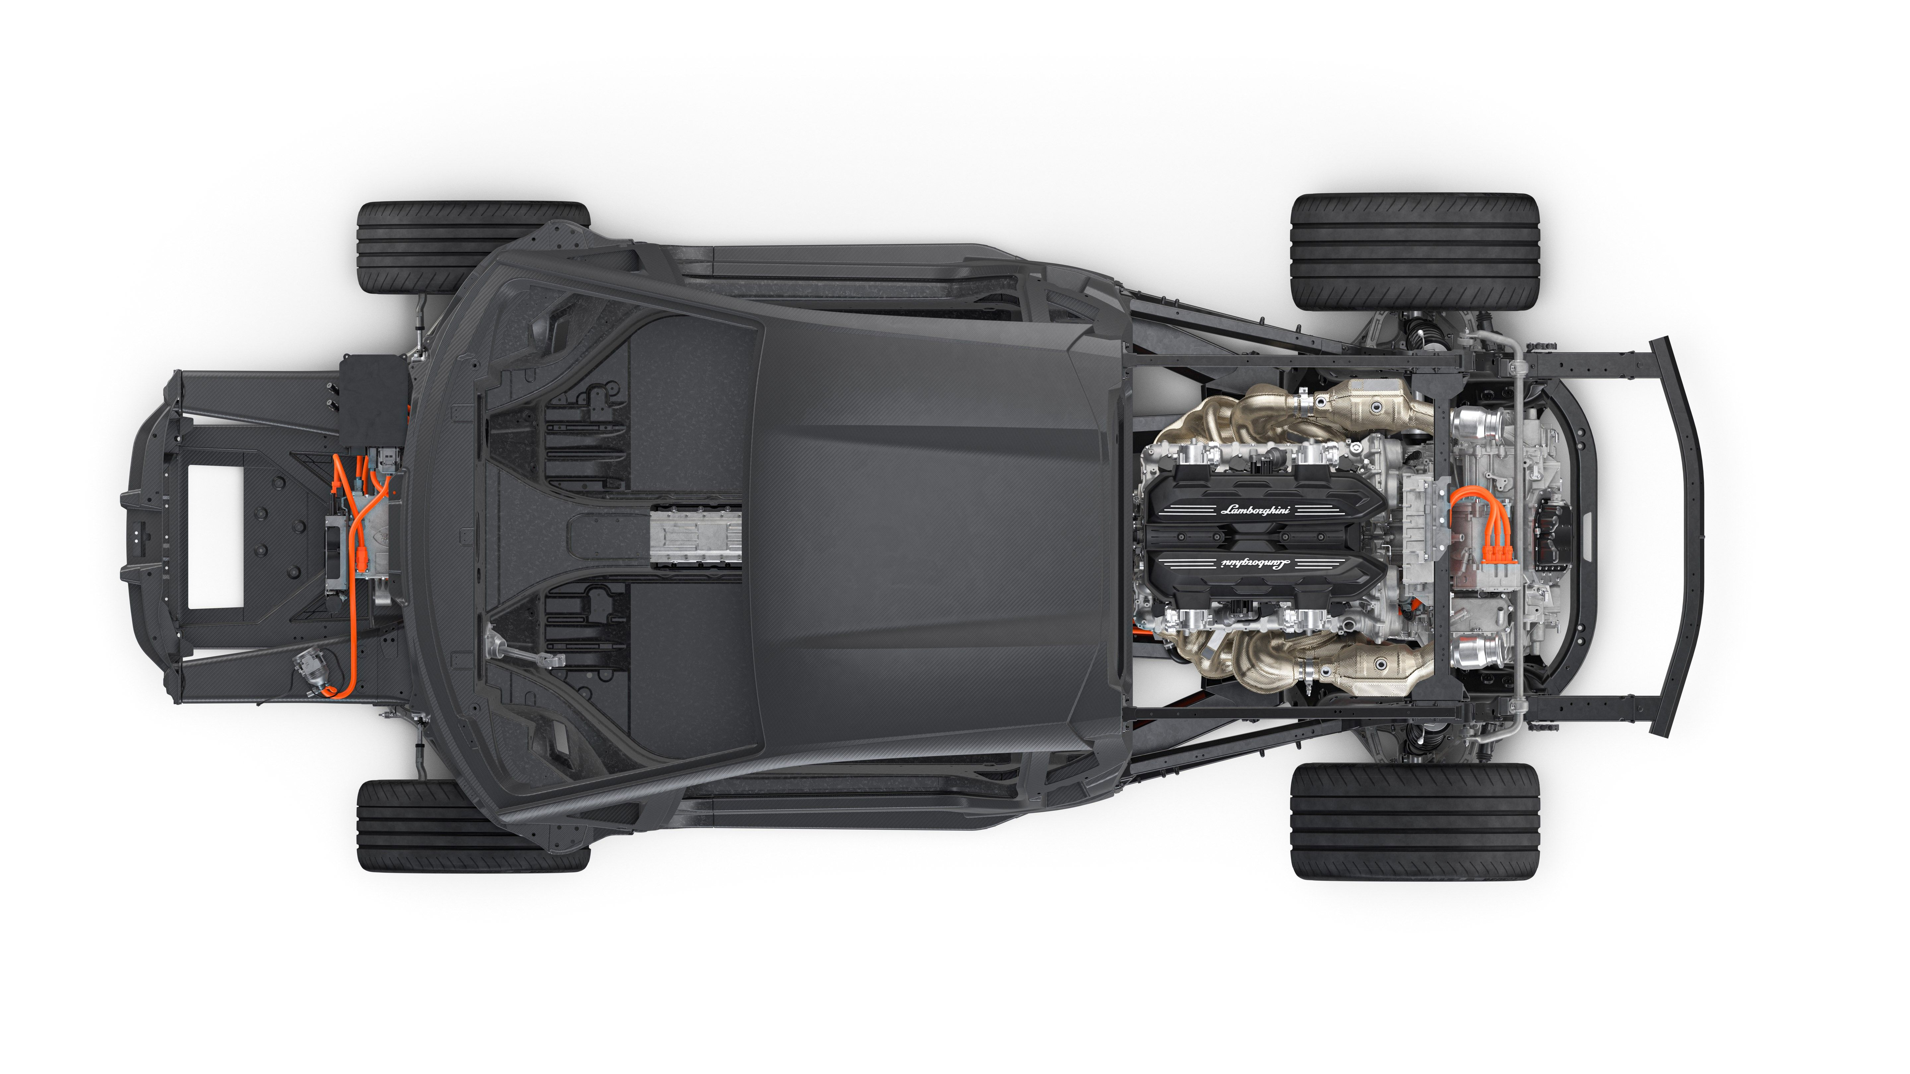
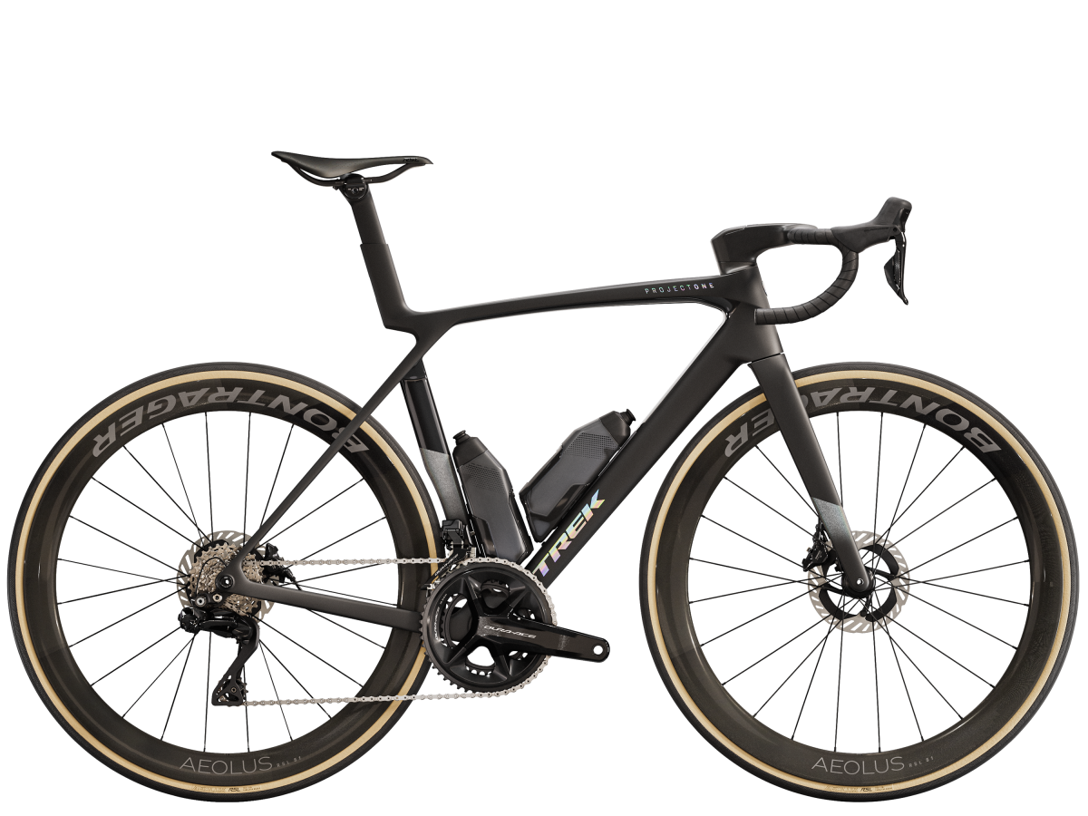
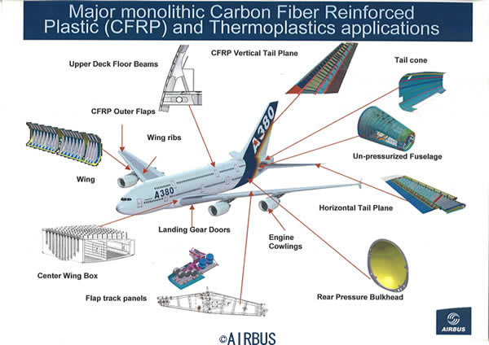
Background Information Additional information
Carbon Fiber Reinforced Thermoplastic (CFRTP)
Lamborghini Aventador CFTP parts
Notes:
Carbon Fiber Reinforced Thermoplastic (CFRTP) is a composite material that combines carbon fiber with a thermoplastic matrix, offering a high strength-to-weight ratio, durability, and recyclability compared to thermoset composites. It can be easily reshaped when heated, simplifying manufacturing and facilitating repairs, making it an ideal material for various industries where weight reduction, material strength and high upkeep is necessary. In industries like the automotive industry with the Lamborghini Aventador where carbon fiber is used in the frame of the vehicle, the aerospace industry where planes like the Airbus A380 uses CFRTP for various parts like the wings and the vertical tail wing. Trek's Madone bike frames leverage CFRTP for stiffness and reduced weight for sports equipment.

Slide 22
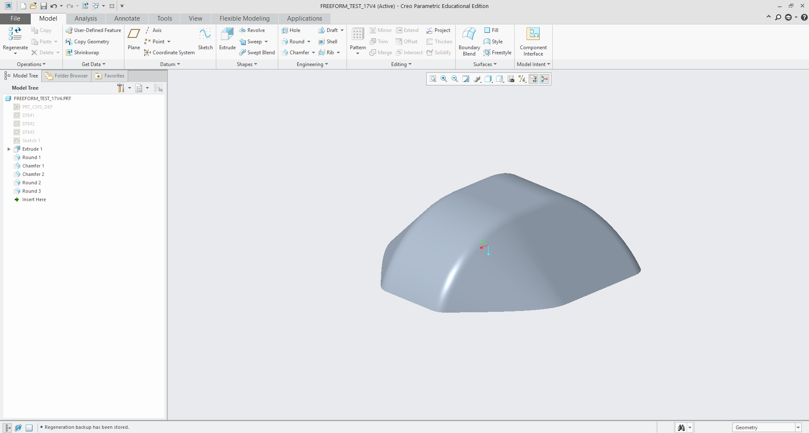
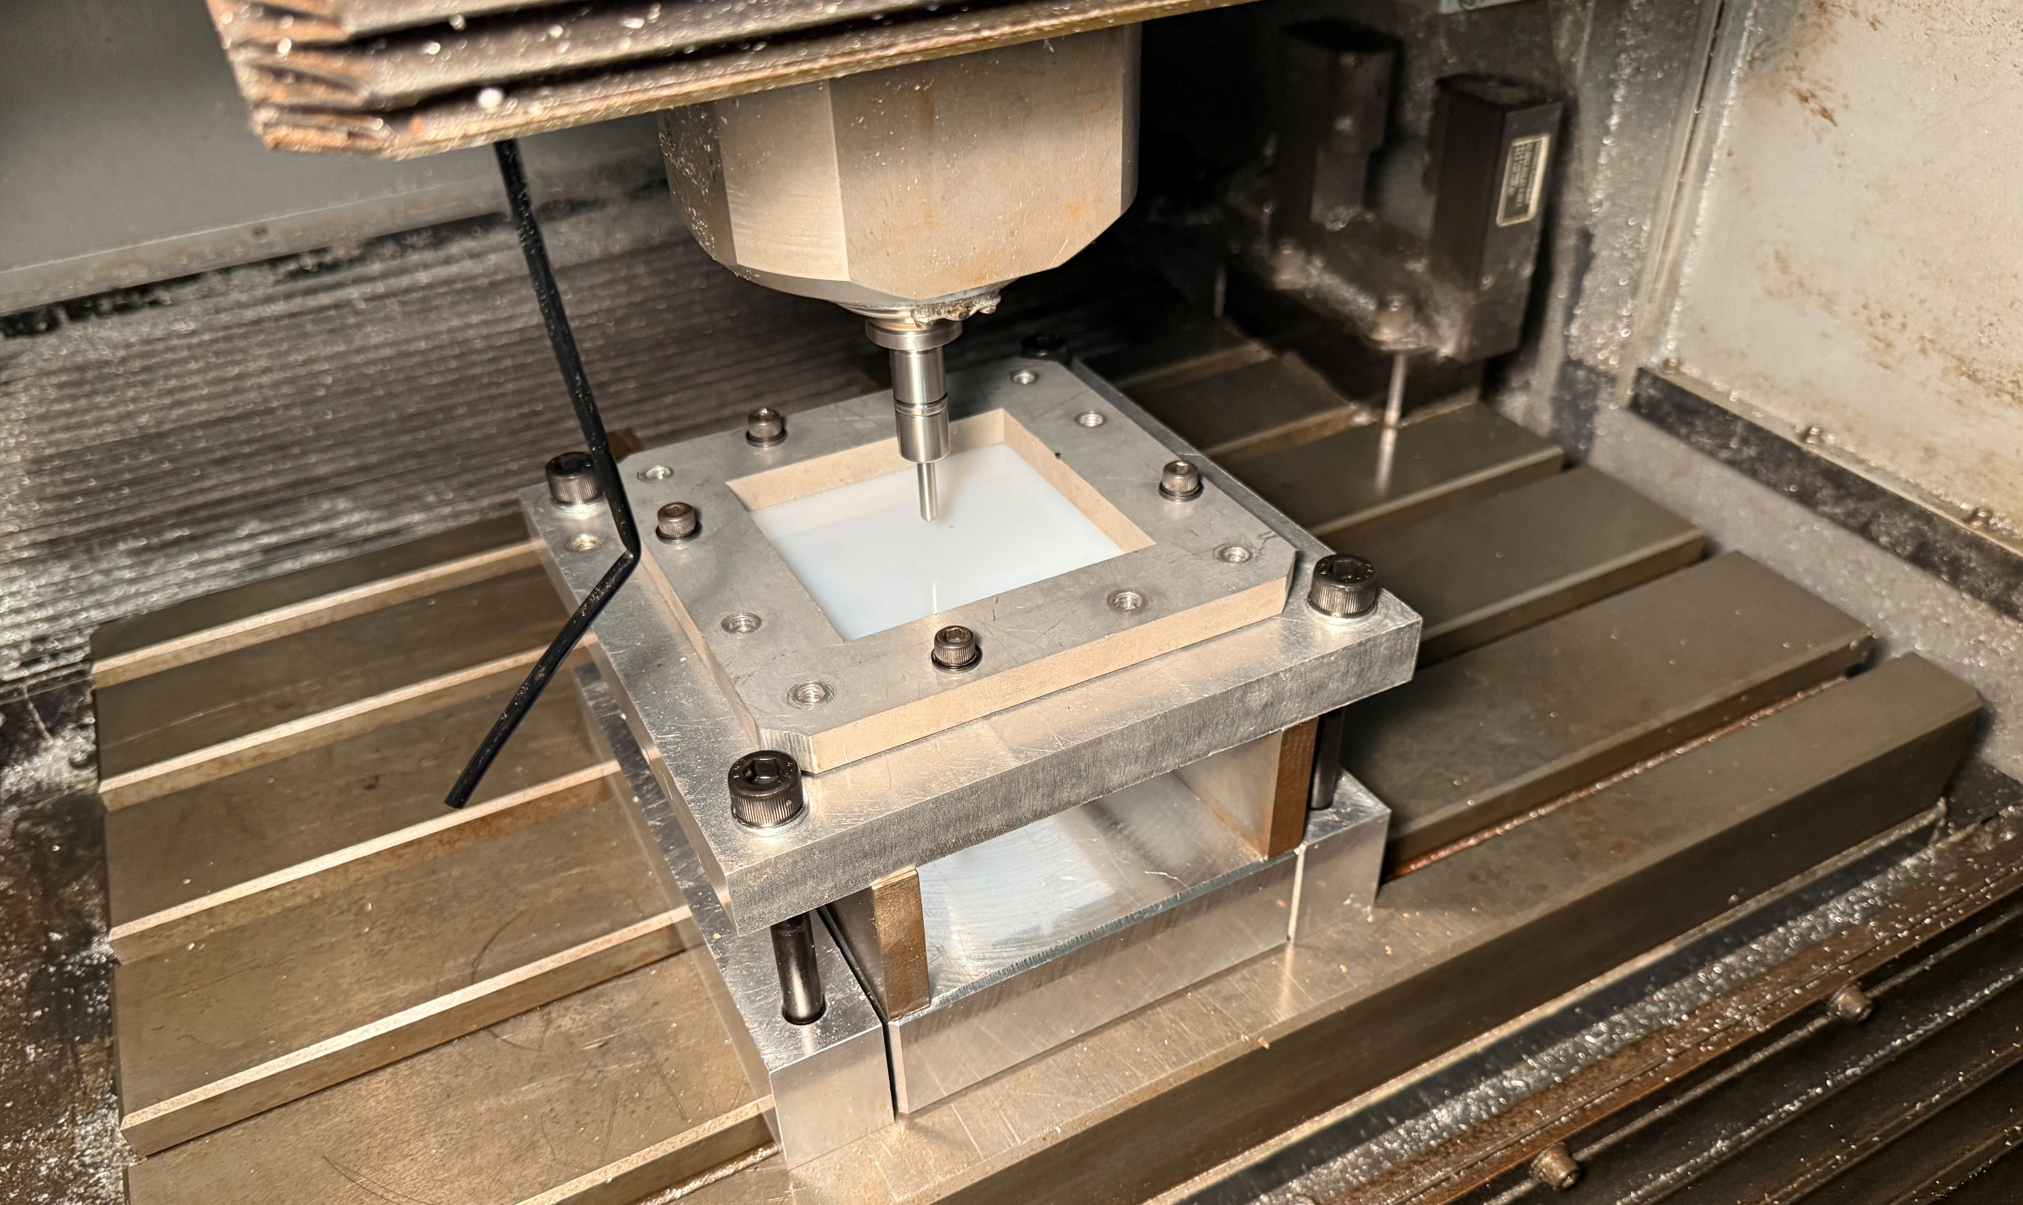
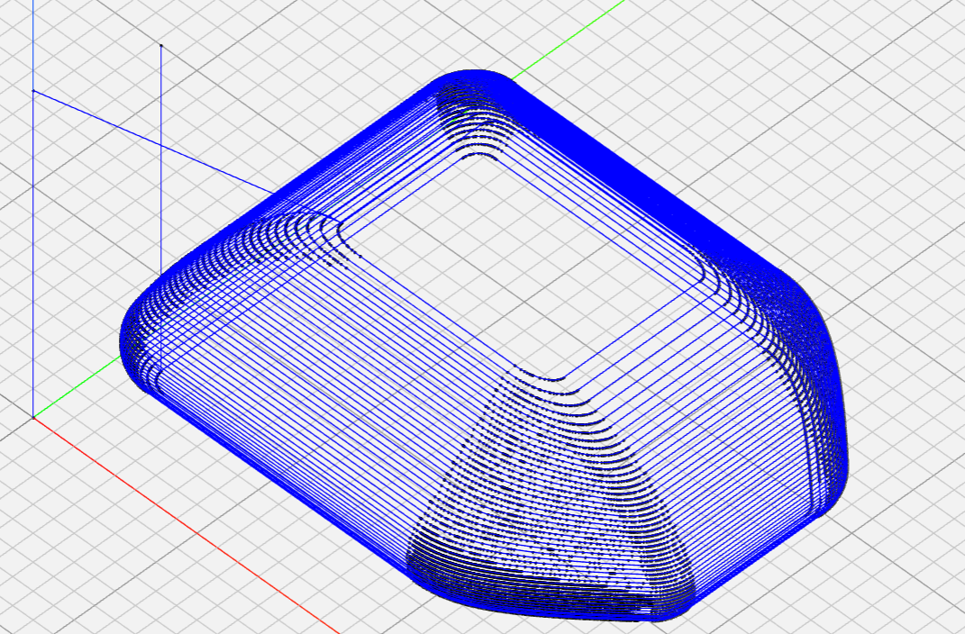
Background Information Incremental Forming
CAD
Forming
Tool Path
Notes:
So, what is Incremental forming?
Incremental forming is a flexible forming process that can shape sheets of various materials using plastic deformation of the sheet with a tool into the desired shape.
Unlike traditional manufacturing processes, it does not require dies or molds, making it ideal for low-volume production, prototyping, or custom parts. The tool follows a programmed path to manufacture shell shapes, offering reduced setup and production costs.
It also allows the production of various products in small quantities, where mold creation would be too expensive.

Slide 23
Experimental Equipment
T -22H Oil Bath
CFRTP Test Piece
Notes:
Between now and the next presentation, my goal is to conduct experiments with CRTP in an oil bath with and without the mold. I will also learn how to use the 3D scanner to analyze the results, as right now, it is hard to determine accurately if the test piece was formed to the correct specifications.
After this, I will attempt to improve the formability of the test shape.
The experimental equipment will be the same as that used in previous research. The T -22H oil bath and silicon oil will be used to heat the CFRTP for forming.
The test piece will be a sheet of CFRTP that is 110 mm × 110 mm thick and 1 mm thick.

Slide 24

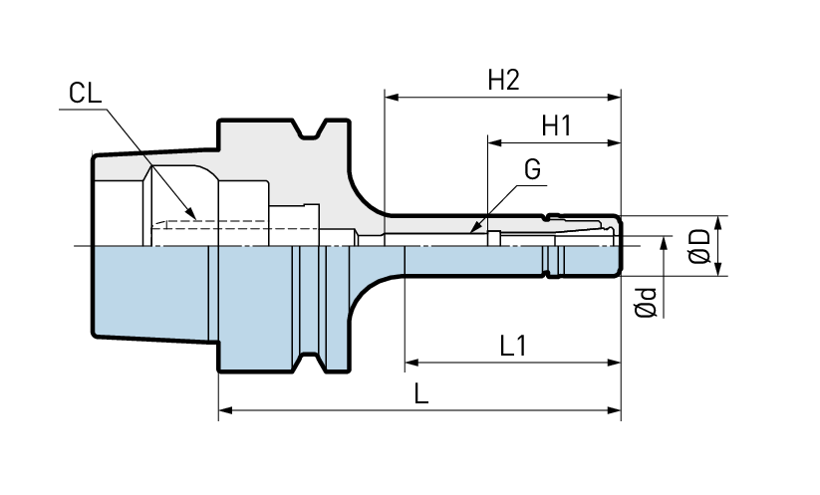
Experimental Equipment
Mega Micro type S Chuck
Ød : | 0.45 - 6.05
ØD: | 14 mm
L: | 45
L1: | 32
G: | -
H1: | 28
H2: | 31

Slide 25
Add python code here
Add any other figures needed.

Slide 26
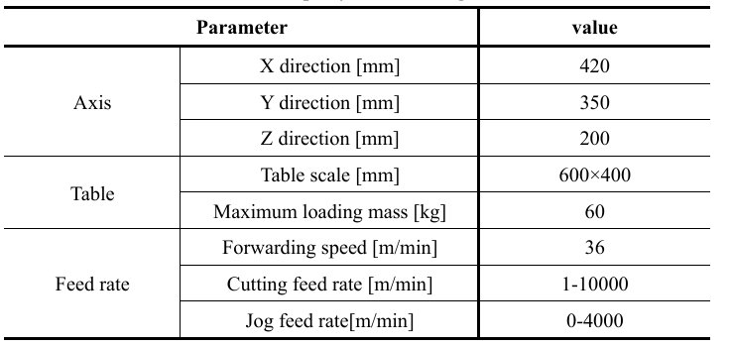
Experimental equipment
MC430L machining center

Slide 27
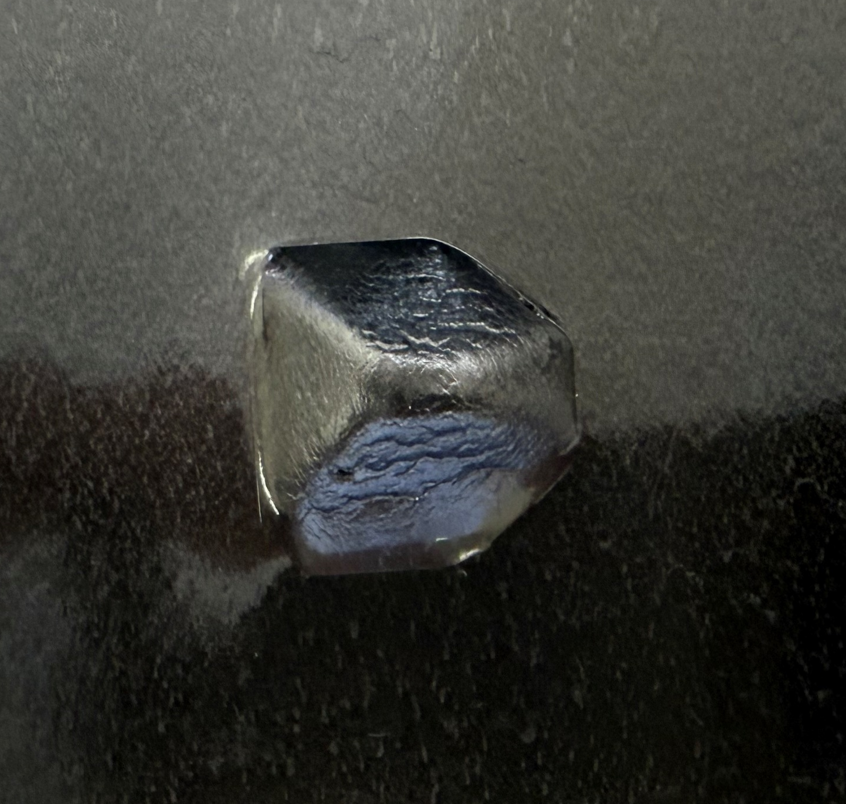
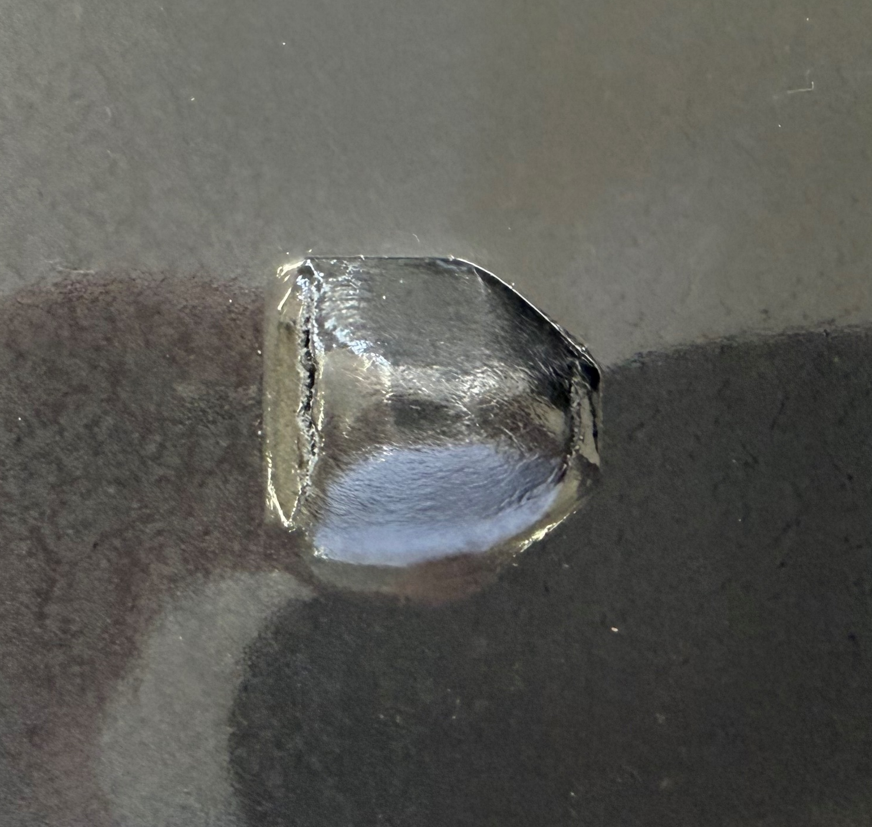
CFRTP experiments
Tests With a Mold with CFRTP
Test Number | Feed Rate (mm/min) | Spindle Speed (RPM) | Temperature (Degrees C) | Forming depth (mm)
1 | 400 | 400 | 120 | 9.96
2 | 1000 | 500 | 120 | 8.75
3 | 1000 | 500 | 150 | 10.80
Test 1
Test 2
Test 3
Notes:
As mentioned before, The updated CAM system significantly reduced toolpath generation time for a complex test shape from 2.5 hours to 2 seconds. The tests demonstrated that the toolpath of the enhanced CAM system worked. The tests with a mold achieved better results, consistently forming depths ranging from 8 to 10 mm and retaining the test shape better than in the tests without the mold. The system excels in handling complex geometries and streamlining manufacturing, but further research is needed to optimize CFRTP forming and enhance analysis methods.

Slide 28
CFRTP experiments
Tests Without a Mold With CFRTP
Test Number | Feed Rate (mm/min) | Spindle Speed (RPM) | Temperature (Degrees C) | Forming depth (mm)
1 | 1000 | 500 | 150 | 9.85
Test Without the Mold
Notes:
As mentioned before, The updated CAM system significantly reduced toolpath generation time for a complex test shape from 2.5 hours to 2 seconds. The tests demonstrated that the toolpath of the enhanced CAM system worked. The tests with a mold achieved better results, consistently forming depths ranging from 8 to 10 mm and retaining the test shape better than in the tests without the mold. The system excels in handling complex geometries and streamlining manufacturing, but further research is needed to optimize CFRTP forming and enhance analysis methods.

Slide 29
Issues with previous research CAM system
Suboptimal Paths: The method uses a greedy nearest-neighbor heuristic, which often produces suboptimal paths. For TSP, this can result in significantly longer total path lengths compared to optimal or near-optimal solutions, increasing machining time and energy use in incremental forming.
Lack of Optimization: It doesn’t consider global optimization techniques (e.g., dynamic programming, branch-and-bound, or metaheuristics like simulated annealing), which TSP libraries employ to find better solutions.
Code Complexity and Maintenance: The code is complex, with manual handling of arrays, loops, and file I/O (e.g., saving and loading layer.csv). This increases the risk of bugs and makes it harder to maintain or extend compared to a library’s streamlined API.
Scalability Issues: For large point clouds (common in incremental forming), the iterative distance calculations and array manipulations (e.g., np.linalg.norm, np.delete) are computationally inefficient, leading to slow performance.
Limited Flexibility: The method is tailored to a specific point cloud structure and doesn’t easily adapt to variations like weighted graphs, constraints (e.g., toolpath continuity), or alternative distance metrics.

Slide 30
CFRTP Experimental conditions
Previous Research Experimental Conditions:
Angle: | 40°
Feed Rate: | 1000 mm/min
Test Shape Radius: | 20 mm
Pitch: | 1 mm
Depth: | 15 mm
Temperature: | 393K (120°C)
Spindle rotation: | 1000 rpm
Experimental Conditions for the Following Experiments:
Angle: | 45°
Feed Rate: | 1000 mm/min
Test Shape Dimensions: | 30 mm x 30 mm
Pitch: | 1 mm
Depth: | 9.9 mm
Temperature: | 393K (120°C)
Spindle rotation: | 1000 rpm
Notes:
The experimental conditions used for the oil testing will be based on the previous research's experimental conditions for the experiment that had the best results, as shown in the table on the right. The feed rate, spindle rotation, pitch, and temperature will be the same, while the other conditions will differ as the test shape is different.

Slide 31
CAM System Changes CAM System Overview
STL Loading Method:
Point Processing and Filtering:
Removes duplicate and invalid coordinates
Layer Identification:
Sorts unique Z levels from largest to smallest Z levels.
Per-Layer Path Generation:
Computes the convexhull for the outer boundary
Path Ordering and Connection:
Sorts points to form a non-overlapping toolpath
G-Code Generation:
Header (G90 absolute, G21 mm, M03 spindle, speed/feed, rapid to centroid, controlled Z drop)
Configurability:
Configurable parameters
Transforms the STL into a mesh extract vertices by reshaping vectors.
Filters layers with fewer than 5 points.
Reassigns uniform Z levels based on average spacing.
Filters close points (min distance)
Connects layers by starting near the previous layer's exit point.
TOOL_DIAMETER
LAYER_THICKNESS
Z_OFFSET
MIN_DISTANCE,
SAFE_Z_RELATIVE
The toolpath with G01
Footer (safe Z retract, M30 end)
Saves to 'Gchord.txt'.
Output Precision and Rounding:
Rounds coordinates to 2 decimal places.
Offsets and Adjustments:
Applies inward reverse offset by tool diameter using centroid direction
Adds Z springback offset
Adds a global Z drop offset
Smooths points post-offset.
Closes each layer loop
Notes:
The changes to the previous CAM system that were made can be seen on the screen with these nine boxes. Address the issues that the previous CAM system had with sorting or filtering points, adjustments for use in CNC machines, and streamlining the process of design to manufacturing.
The top 6 boxes on the slide deal with the sorting and filtering of points, removing duplicate and invalid points, sorting the points into layers, rounding points to increase the accuracy of the toolpath generated, removing layers with fewer than five points, and generating a tool path without inefficiencies.
The bottom left box deals with the adjustments to the tool path so that it can be used in a CNC machine. These adjustments consider the tool's diameter, the spring back of a material, and the machining center's physical constraints.
The final two boxes streamline the design to manufacturing process by allowing the user to adjust the code depending on experimental equipment and conditions, and automatically adding the initial setup commands and termination sequence that every toolpath needs.
#Hide the slide
# remove the
#bullet points more effective
#Change to one or two slides explain what I did

Slide 32
Conclusion
Metric | Previous Research (Truncated Cone) | Current Research (Complex Shape) | Difference
Max Depth (mm) | 14.9 (small radius) | 10.8 (with mold) | -4.1 mm (-27.5%)
Min Depth (mm) | 8 (large radius) | 9.8 (without mold) | +1.8 mm (+22.5%)
Springback (%) | <5% (good angles) | ~5.05% (inferred) | Comparable
Test Condition | Temperature (°C) | Achieved Depth (mm) | Deviation from Target (mm) | Relative Error (%) | Achievement (%)
With Mold | 150 | 10.8 | +0.9 | +9.09 | 109.09
Without Mold | 150 | 9.80 | -0.1 | -1.01 | 98.99
Mean | N/A | 10.3 | +0.4 | +4.04 | 104.04
Notes:
This study successfully improved the previous research's CAM system, addressed several limitations the prior CAM system had, and solved three issues: generating precise, error-free toolpaths for complex geometries, reducing toolpath generation time for complex geometries, and streamlining the design-to-manufacturing process.
The updated CAM system achieves near-100% time reduction, enabling rapid prototyping. Forming depths are within ~5% error of target on average, with molds improving consistency (lower error without over-forming).
Temperature at 150°C is critical, aligning with the previous researches temperature.
Small sample sizes (e.g., n=2 for CFRTP depths) prevent advanced stats like t-tests or ANOVA. No variance data for nylon tests or thickness measurements. Future work could quantify point reduction in CAM (e.g., pre/post-filtering counts) and add more replicates for depths (target n≥10 per condition) to compute reliable standard deviations. Integrate sensor data (e.g., force in Newtons) for correlation analysis (e.g., depth vs. temperature: linear regression slope from previous data ~0.1 mm/°C increase above 50°C).

